Slide 1
Pipelining and RISC Architecture
Muhammad Asim
Notes:
In today’s lecture, we will learn pipelining. It’s a fundamental technique that makes computers so fast.

Slide 2
Outline
what’s pipelining
pipelining principles
RISC and its five-stage pipeline
Notes:
In the first part, we’ll walk through some examples analogous to pipelining, introduce pipelining’s principles, and a five-stage pipeline for RISC processors.

Slide 3
Laundry Example
Ann, Brian, Cathy, Dave
Each has one load of clothes to
wash, dry, fold.
washer
30 mins
dryer
40 mins
folder
20 mins
Notes:
Say four students each with a load of clothes to wash, dry, and fold.
The washer takes 30 mins, dryer 40 minis, and folder 20 mins.

Slide 4
Sequential Laundry
6 Hours
Time
30 40 20
30 40 20
30 40 20
30 40 20
A
Task Order
B
C
D
What would you do?
Notes:
When they perform the laundry tasks in a sequential fashion, A does the laundry first, and only when A completes can B start. Similarly, C after B, and D after C.
In this case, the sequential laundry will take up to 6 hours.
But the question is, will anybody do it like this in real life? Actually, after A uses the washer, B can immediately starts washing without further waiting.

Slide 5
Sequential Laundry
6 Hours
Time
30 40 20
30 40 20
30 40 20
30 40 20
A
Task Order
B
C
D
What would you do?
Notes:
And then B can start drying after A finishes drying, and start folding after A finishes folding.

Slide 6
Pipelined Laundry
3.5 Hours
Observations
A task has a series of stages;
Stage dependency:
e.g., wash before dry;
Multi tasks with overlapping stages;
Simultaneously use diff resources to speed up;
Slowest stage determines the finish time;
Time
30 40 40
40 40 20
A
Task Order
B
C
D
Notes:
Following this way, the laundry task execution will look like this. We call such laundry execution pipelined laundry, in which a laundry task can start before previous one completes.
The pipelined laundry takes only 3 and a half hours, which is much shorter than 6 hours taken by the sequential laundry.
Before we delve into the definition of pipelining in computer architecture, let’s see what observations we can get from this pipelined laundry example.
First, a task has a series of stages. For example, a laundry task has three stages, washing, drying, and folding.
Second, connecting stages have dependency upon each other. For example, you need to wash clothes before you dry them.
When there are multiple tasks to run, simultaneously using different resources can accelerate the execution.
A deeper observation is that the slowest stage determines the finish time. In this example, the dryer takes the longest time of 40 mins. And it’s obvious that the dryer decides when the last task will finish.

Slide 7
Pipelined Laundry
3.5 Hours
Observations
No speed up for individual task;
e.g., A still takes 30+40+20=90
But speed up for average task execution time;
e.g., 3.5*60/4=52.5 < 30+40+20=90
Time
30 40 40
40 40 20
A
Task Order
B
C
D
Notes:
Another important observation is that an individual task doesn’t become faster. For example. A still takes 90 mins for laundry.
On the contrary, it’s the average task execution time that becomes much shorter. In this case, four tasks take 3 and a half hours, with each taking about 52 mins, which is much shorter than the original 90 mins.

Slide 8
Pipelining
An implementation technique whereby multiple instructions are overlapped in execution.
e.g., B wash while A dry
Essence: Start executing one instruction before completing the previous one.
Significance: Make fast CPUs.
A
B
Notes:
Pipelining is an implementation technique whereby multiple instructions are overlapped in execution. Take the pipelined laundry for example. B uses the washer while A uses the dryer.
Its essence is to start executing one instruction before completing the previous one. And its significance is therefore to make fast CPUs.

Slide 9
Balanced Pipeline
Equal-length pipe stages
e.g., Wash, dry, fold = 40 mins
per unpipelined laundry time = 40x3 mins
3 pipe stages – wash, dry, fold
40min
T1
A
T2
B
A
T3
C
B
A
T4
D
C
B
Notes:
The ideal case for pipelining is balanced pipeline. In a balanced pipeline, all pipe stages have equal duration.
Consider again the laundry example with each stage taking 40 mins. Then the unpipelined laundry will take 40 times 3 mins to finish one task.
Now let’s recap how pipelined laundry will perform the four tasks.
In the first time duration T1, A uses the washer; In T2, A uses the dryer while B uses the washer; In T3, A uses the folder, B uses the dryer, while C uses the washer. Starting from T3, all resources are fully used in the same duration. Then the pipelined laundry takes 40 mins on average to complete one task. Based on this observation, we have two performance properties of balanced pipeline. One is the time per instruction by pipeline is equal to time per instruction on unpipelined machine over the number of pipe stages. The other is speed up by pipeline is equal to the number of pipe stages.

Slide 10
Balanced Pipeline
Equal-length pipe stages
e.g., Wash, dry, fold = 40 mins
per unpipelined laundry time = 40x3 mins
3 pipe stages – wash, dry, fold
40min
T1
A
T2
B
A
T3
C
B
A
T4
D
C
B
Notes:
In the first time duration T1, A uses the washer;
In T2, A uses the dryer while B uses the washer; In T3, A uses the folder, B uses the dryer, while C uses the washer. Starting from T3, all resources are fully used in the same duration. Then the pipelined laundry takes 40 mins on average to complete one task. Based on this observation, we have two performance properties of balanced pipeline. One is the time per instruction by pipeline is equal to time per instruction on unpipelined machine over the number of pipe stages. The other is speed up by pipeline is equal to the number of pipe stages.

Slide 11
Balanced Pipeline
Equal-length pipe stages
e.g., Wash, dry, fold = 40 mins
per unpipelined laundry time = 40x3 mins
3 pipe stages – wash, dry, fold
40min
T1
A
T2
B
A
T3
C
B
A
T4
D
C
B
Notes:
In T2, A uses the dryer while B uses the washer;
In T3, A uses the folder, B uses the dryer, while C uses the washer. Starting from T3, all resources are fully used in the same duration. Then the pipelined laundry takes 40 mins on average to complete one task. Based on this observation, we have two performance properties of balanced pipeline. One is the time per instruction by pipeline is equal to time per instruction on unpipelined machine over the number of pipe stages. The other is speed up by pipeline is equal to the number of pipe stages.

Slide 12
Balanced Pipeline
One task/instruction
per 40 mins
Equal-length pipe stages
e.g., Wash, dry, fold = 40 mins
per unpipelined laundry time = 40x3 mins
3 pipe stages – wash, dry, fold
Performance
Time per instruction by pipeline =
Time per instr on unpipelined machine
Number of pipe stages
Speed up by pipeline =
Number of pipe stages
40min
T1
A
T2
B
A
T3
C
B
A
T4
D
C
B
Notes:
In T3, A uses the folder, B uses the dryer, while C uses the washer.
Starting from T3, all resources are fully used in the same duration. Then the pipelined laundry takes 40 mins on average to complete one task. Based on this observation, we have two performance properties of balanced pipeline. One is the time per instruction by pipeline is equal to time per instruction on unpipelined machine over the number of pipe stages. The other is speed up by pipeline is equal to the number of pipe stages.

Slide 13
Pipelining Terminology
Latency: the time for an instruction to complete.
Throughput of a CPU: the number of instructions completed per second.
Clock cycle: everything in CPU moves in lockstep; synchronized by the clock.
Processor Cycle: time required between moving an instruction one step down the pipeline;
= time required to complete a pipe stage;
= max(times for completing all stages);
= one or two clock cycles, but rarely more.
CPI: clock cycles per instruction
Notes:
Here are some frequently used definitions about pipelining.
Latency is measured by the time for an instruction to complete.
Throughput is measured by the number of instructions a CPU can complete per second.
Clock cycle is the time duration of one lockstep of CPU.
Processor cycle is the time required to complete a pipe stage. As we observed from the laundry example, the slowest stage determines the length of a processor cycle. It usually spans one or two clock cycles.
CPI represents the number of clock cycles an instruction takes.

Slide 14
RISC: Reduced Instruction Set Computer
Properties:
All operations on data apply to data in registers and typically change the entire register (32 or 64 bits per reg);
Only load and store operations affect memory;
load: move data from mem to reg;
store: move data from reg to mem;
Only a few instruction formats; all instructions typically being one size.
Notes:
RISC stands for reduced instruction set computer.
A RISC processor has the following properties.
All operations on data apply to data in registers. Only load and store operations affect memory. The load operation moves data from memory to register. The store operation moves data from register to memory.
And RISC has only a few instruction formats with each being one size.

Slide 15
RISC: Reduced Instruction Set Computer
32 registers
3 classes of instructions - 1
ALU (Arithmetic Logic Unit) instructions
operate on two regs or a reg + a sign-extended immediate;
store the result into a third reg;
e.g., add (DADD), subtract (DSUB)
logical operations AND, OR
Notes:
RISC has 32 registers and 3 classes of instructions.
The first class is ALU instruction. It usually operates on two registers and stores the result into a third register. Typical ALU instructions include add, subtract, and logical operations such as AND, OR.

Slide 16
RISC: Reduced Instruction Set Computer
3 classes of instructions - 2
Load (LD) and store (SD) instructions
operands: base register + offset;
the sum (called effective address) is used as a memory address;
Load: use a second reg operand as the destination for the data loaded from memory;
Store: use a second reg operand as the source of the data stored into memory.
Notes:
The second class is Load and Store instructions that affect memory.
They first get the memory address by adding the base register and an offset. The load instruction uses a second register operand as the data destination while the store instruction uses a second register as the data source.

Slide 17
RISC: Reduced Instruction Set Computer
3 classes of instructions - 3
Branches and jumps
conditional transfers of control;
Branch:
specify the branch condition with a set of condition bits or comparisons between two regs or between a reg and zero;
decide the branch destination by adding a sign-extended offset to the current PC (program counter);
Notes:
The third class is branches and jumps that make conditional transfers of control.
We temporarily focus only on branches.
A branch instruction consists of two phases. The first phase specifies the branch condition to decide whether the branch should take effect. It’s just like an if-else in programming language. The branch condition can be verified via a set of condition bits or comparison between two registers.
If the branch condition is satisfied, the second phase decides the branch destination. That is, where to fetch the next instruction.

Slide 18
RISC: Reduced Instruction Set Computer
at most 5 clock cycles per instruction – 1
IF ID EX MEM WB
Instruction Fetch cycle
send the PC to memory;
fetch the current instruction from mem;
PC = PC + 4; //each instr is 4 bytes
Notes:
RISC has at most 5 clock cycles per instruction.
The first cycle is IF for fetching the current instruction from memory.
To do so, the processor sends the program counter to memory, fetches the current instruction from there and then increments the program counter by 4.

Slide 19
RISC: Reduced Instruction Set Computer
at most 5 clock cycles per instruction – 2
IF ID EX MEM WB
Instruction Decode/register fetch cycle
decode the instruction;
read the registers (corresponding to register source specifiers);
Notes:
The second cycle is ID for decoding the current instruction.
It reads the registers for later operations.

Slide 20
RISC: Reduced Instruction Set Computer
at most 5 clock cycles per instruction – 3
IF ID EX MEM WB
Execution/effective address cycle
ALU operates on the operands from ID:
3 functions depending on the instr type - 1
-Memory reference: ALU adds base register and offset to form effective address;
Notes:
The third cycle is EX for calculating the effective memory address.
ALU operates on the operands fetched in the ID cycle.
There are 3 classes of functions according to the instruction type. The first class is memory reference, ALU adds base register and offset to form effective address.

Slide 21
RISC: Reduced Instruction Set Computer
at most 5 clock cycles per instruction – 3
IF ID EX MEM WB
Execution/effective address cycle
ALU operates on the operands from ID:
3 functions depending on the instr type - 2
-Register-Register ALU instruction: ALU performs the operation specified by opcode on the values read from the register file;
Notes:
The second class is register-register ALU instruction: in this case, ALU performs the operation specified by opcode on the values in the register file.

Slide 22
RISC: Reduced Instruction Set Computer
at most 5 clock cycles per instruction – 3
IF ID EX MEM WB
EXecution/effective address cycle
ALU operates on the operands from ID:
3 functions depending on the instr type - 3
-Register-Immediate ALU instruction: ALU operates on the first value read from the register file and the sign-extended immediate.
Notes:
The third class is register-immediate ALU instruction. For this type, ALU operates on the first value read from the register file and the immediate.

Slide 23
RISC: Reduced Instruction Set Computer
at most 5 clock cycles per instruction – 4
IF ID EX MEM WB
MEMory access
for load instr: the memory does a read using the effective address;
for store instr: the memory writes the data from the second register using the effective address.
Notes:
The fourth cycle is MEM for memory access. As aforementioned, there are two types of instructions affecting the memory. For load instruction, the memory does a read using the effective address.
For store instruction, the memory writes some data using the effective address.

Slide 24
RISC: Reduced Instruction Set Computer
at most 5 clock cycles per instruction – 5
IF ID EX MEM WB
Write-Back cycle
for Register-Register ALU or load instr;
write the result into the register file, whether it comes from the memory (for load) or from the ALU (for ALU instr).
Notes:
The fifth cycle is WB for writing the result into the register file.
The result may come from the memory if it’s a load instruction or from the ALU if it’s an ALU instruction.

Slide 25
RISC: Reduced Instruction Set Computer
at most 5 clock cycles per instruction
IF ID EX MEM WB
Notes:
So now we have walked through all these five clock cycles of RISC.

Slide 26
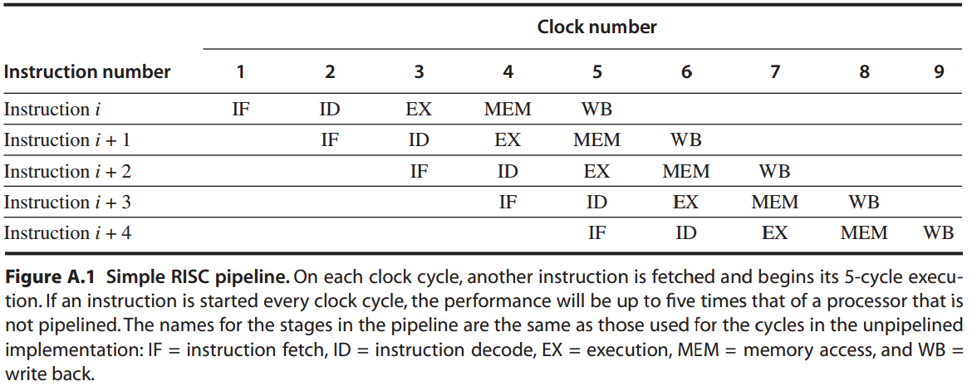
RISC: Five-Stage Pipeline
Simply start a new instruction
on each clock cycle;
Speedup = 5.
Notes:
And this is how they could be pipelined.
We can simply start a new instruction on each clock cycle and make the execution 5 times faster.

Slide 27
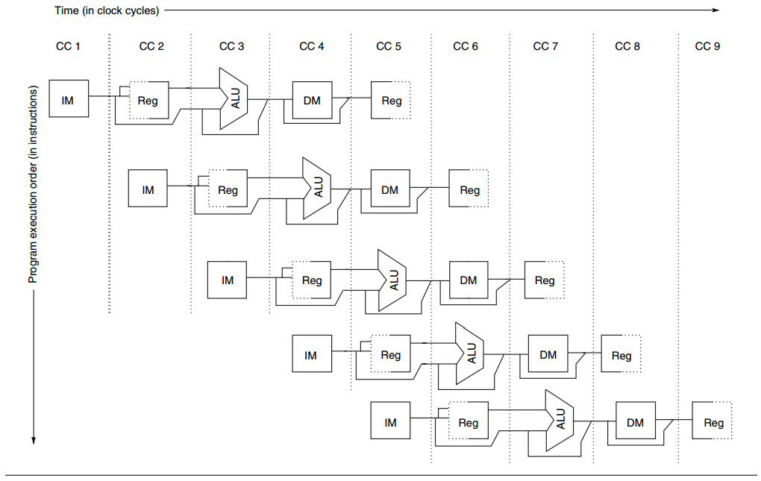
RISC: Five-Stage Pipeline
How it works - omit pipeline regs
for simplicity
but required in implementation
Notes:
For simplicity, some illustrations will omit pipeline registers. But please remember that they are definitely required in implementation.

Slide 28
RISC: Five-Stage Pipeline
Example
Consider an unpipelined instruction.
1 ns clock cycle;
4 cycles for ALU and branches;
5 cycles for memory operations;
relative frequencies 40%, 20%, 40%;
0.2 ns pipeline overhead (e.g., due to stage imbalance, pipeline register setup, clock skew)
Question: How much speedup by pipeline?
Notes:
So we have learned pipelining basics and how pipelining could be implemented. Now let’s see how to calculate the speed up by pipelining via this example. It sates that the unpipelined version has a 1 nanosecond clock cycle. It takes 4 cycles for ALU and branches and 5 for memory operations.
Their relative frequencies are these much. And then there’s 0.2 nanosecond overhead for pipelining. The question is how much is the speed up by pipeline?

Slide 29
RISC: Five-Stage Pipeline
Answer
speedup by pipelining
= Avg instr time unpipelined
Avg instr time pipelined
= ?
Notes:
To find the speed up by pipeline, we need first find the average instruction time when unpipelined and when pipelined.

Slide 30
RISC: Five-Stage Pipeline
Answer
Avg instr time unpipelined
= clock cycle x avg CPI
= 1 ns x [(0.4*4 +0.2*4+ 0.4*5]
= 4.4 ns
Avg instr time pipelined
= 1+0.2
= 1.2 ns
Notes:
Here are how we find these average instruction times.

Slide 31
RISC: Five-Stage Pipeline
Answer
speedup by pipelining
= Avg instr time unpipelined
Avg instr time pipelined
= 4.4 ns
1.2 ns
= 3.7 times
Notes:
Now we have the values of average instruction time when unpipelined and average instruction time when pipelined, we can simply obtain the speed up through their quotient.

